Slide 1


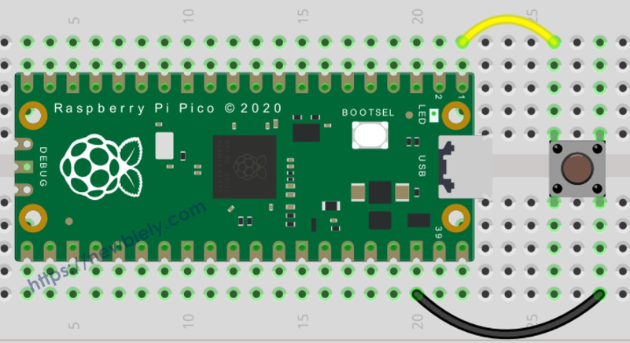
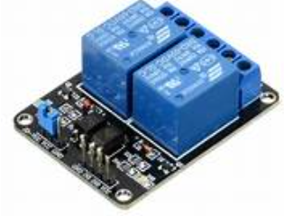
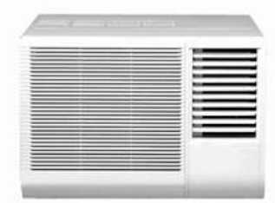
Physical AI – Edge AI Architecture
Raspberry Pi 4 – Edge Server
Presence,Temperature
Python
Script
AI MODEL
LABEL : FAN_ON
IDLE
Inference engine
Decision based on AI Model
Instead of hard-coding

Slide 2
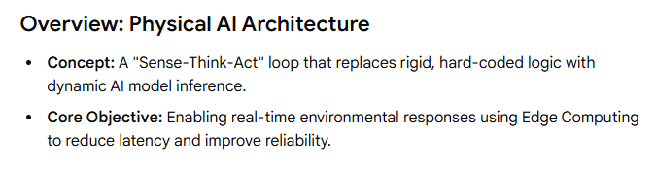
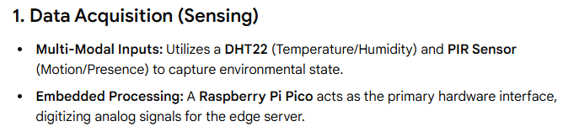
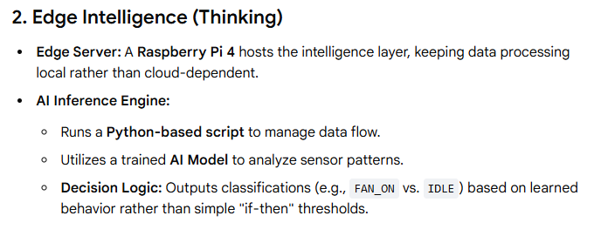

Slide 3
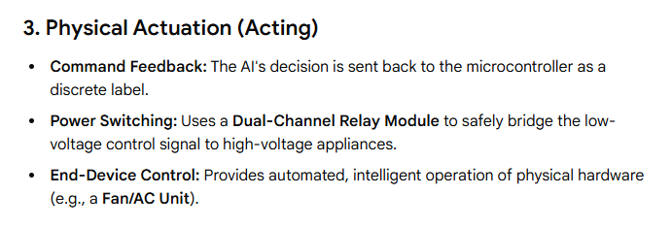
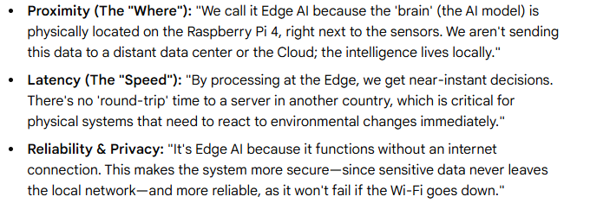
4. Why call it Edge?

Slide 4
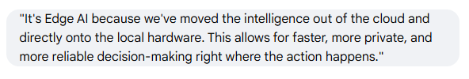
Physical AI – Edge AI Architecture
Raspberry Pi 4 – Edge Server
Presence,Temperature
Python
Script
AI MODEL
LABEL : FAN_ON
IDLE
Inference engine
Decision based on AI Model
Instead of hard-coding

Slide 5
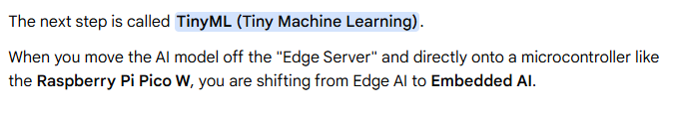
Raspberry Pi 4 – Edge Server
AI MODEL
AI MODEL
Python
Script
Inference engine

Slide 6
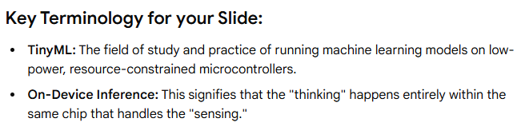
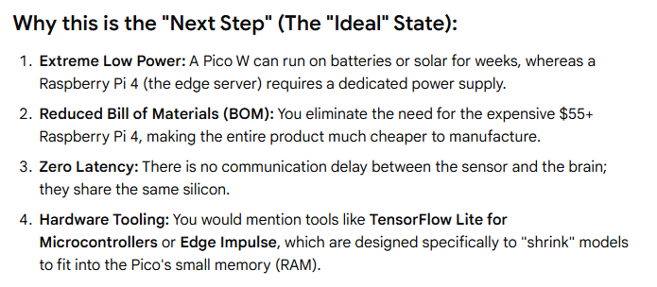

Slide 7
Now a demonstration of how to create an
Edge Impulse Model for our Edge Server

Slide 8
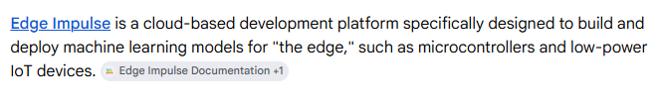
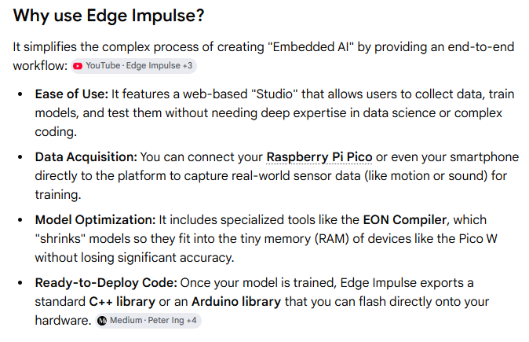

Slide 9
